Slide 1
Tony & Suzy

Slide 2
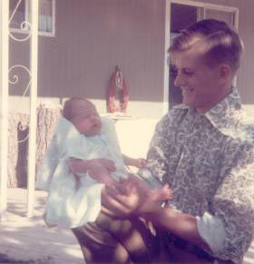
Tony with Dad

Slide 3
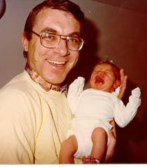
Suzy with Dad

Slide 4
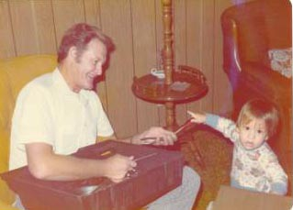
Tony with Grandpa

Slide 5
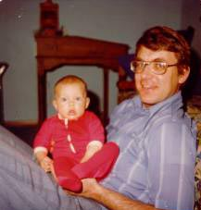
Suzy with Dad

Slide 6
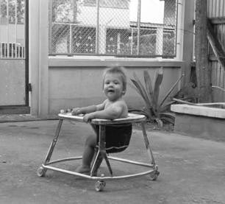
Tony in Thailand

Slide 7
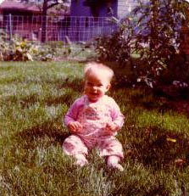
Suzy in Minnesota

Slide 8
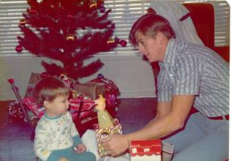
Tony with Jack and Jack-in-the-Box

Slide 9
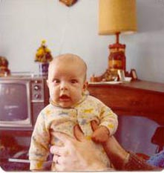
Suzy…bald is beautiful!

Slide 10
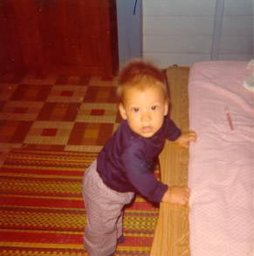
Hang on, Tony!

Slide 11
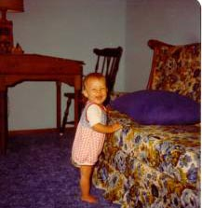
Suzy with ticklish feet.

Slide 12
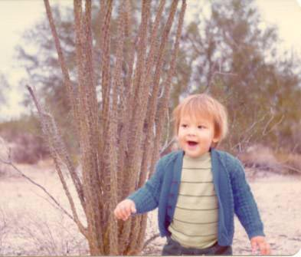
Tony having fun in Arizona

Slide 13
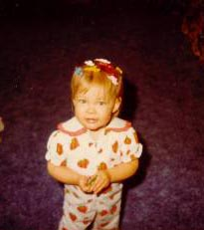
Suzy with all her barrettes!

Slide 14
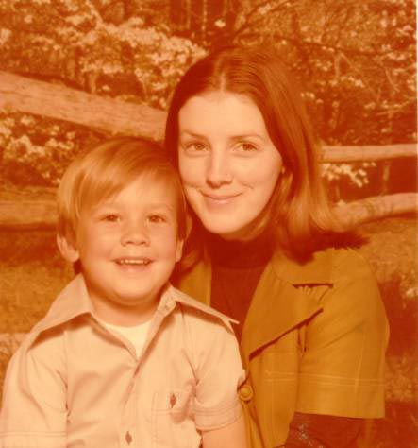
Tony with Mom

Slide 15
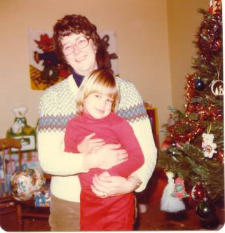
Suzy with curly-Mom

Slide 16
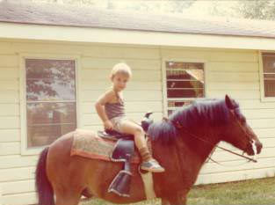
Tony with Cocoa

Slide 17
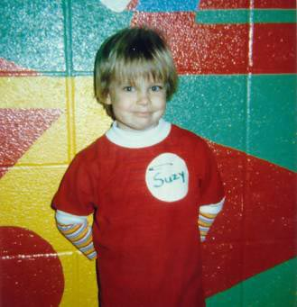
Suzy at preschool…can we go home now??

Slide 18
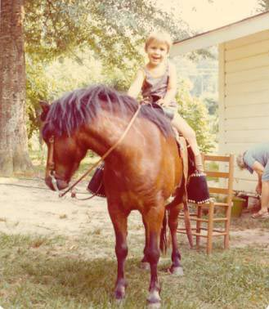
Cocoa’s the greatest!

Slide 19
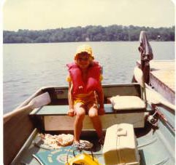
Suzy going fishin’

Slide 20
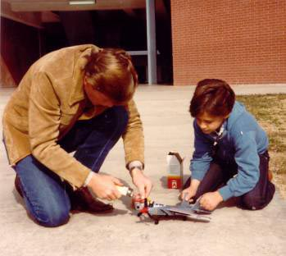
Can you fix it, Dad?

Slide 21
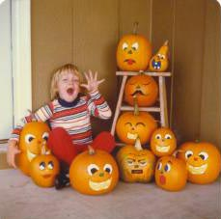
Boo to you from Suzy!

Slide 22
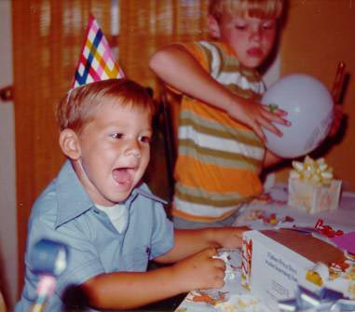
Happy Birthday, Tony!

Slide 23
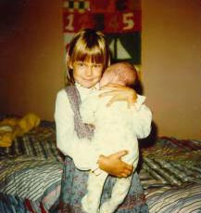
Suzy with baby Julie

Slide 24
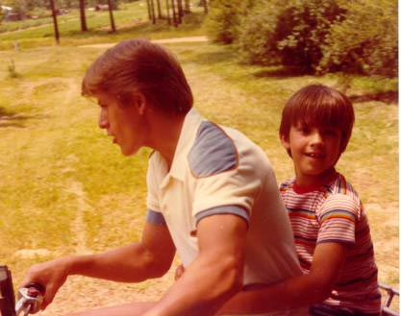
Faster, Dad!

Slide 25
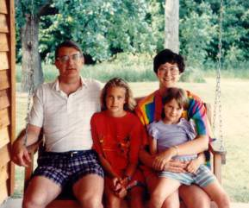
Suzy on Uncle Frank’s porch swing

Slide 26
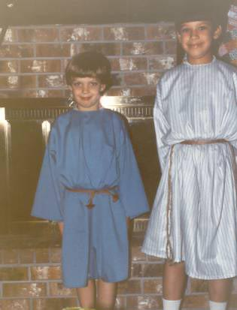
Tony in Christmas pageant

Slide 27
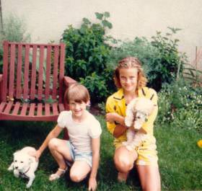
Suzy with Sugar and Julie with Trixie

Slide 28
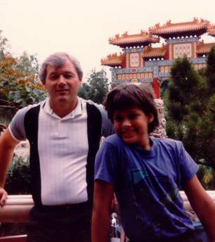
Tony with Darryl

Slide 29
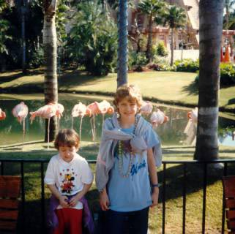
Suzy and Julie at DisneyWorld

Slide 30
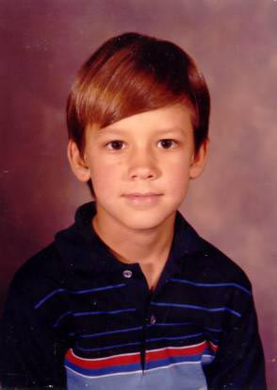
Tony

Slide 31
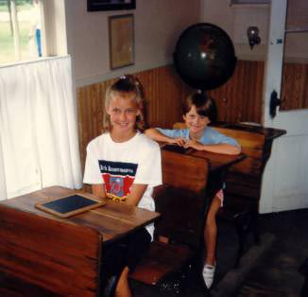
Suzy and Julie at Walnut Grove,
Little House on the Prairie

Slide 32
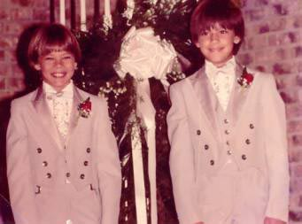
Tony in wedding

Slide 33
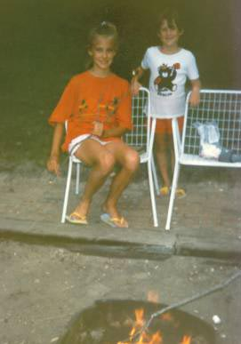
Suzy and Julie camping

Slide 34
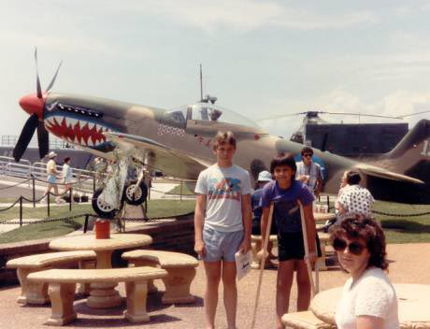
Tony

Slide 35
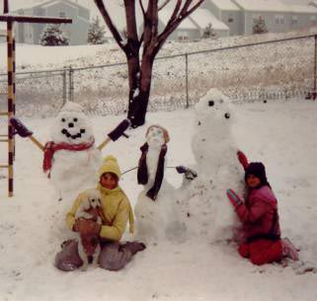
Suzy and Julie with Sugar

Slide 36
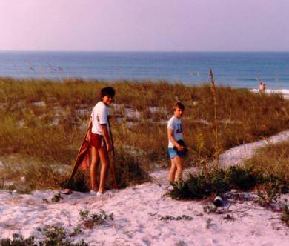
Tony at the Gulf

Slide 37
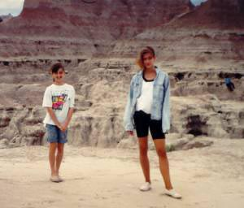
Ya seen one dinosaur, ya seen ‘em all!

Slide 38
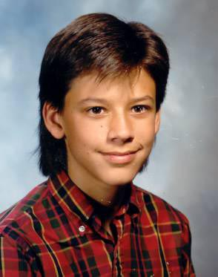
Tony

Slide 39
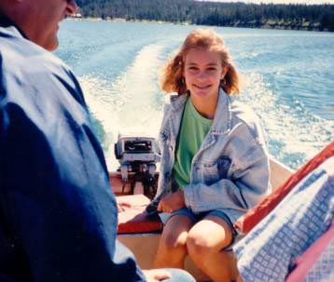
Suzy going fishing at Glacier

Slide 40
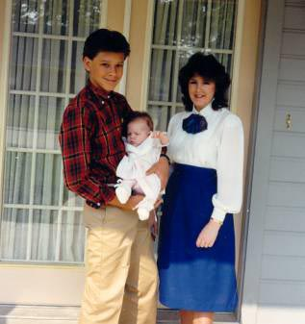
Tony with baby sister Jennifer

Slide 41
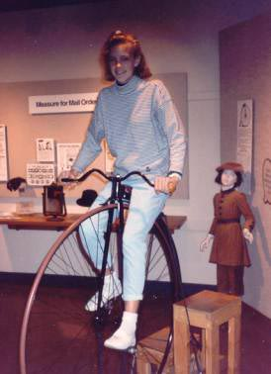
Suzy…no training wheels?!

Slide 42
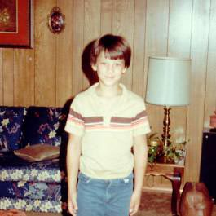
Tony

Slide 43
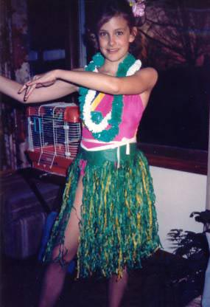
Aloha to you!

Slide 44
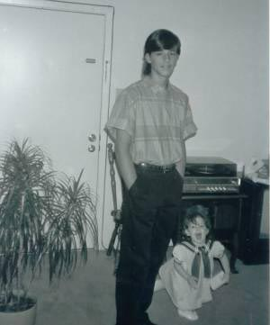
We hear you, Jennifer!

Slide 45
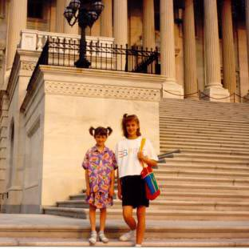
Suzy and Julie in Washington, D.C.

Slide 46
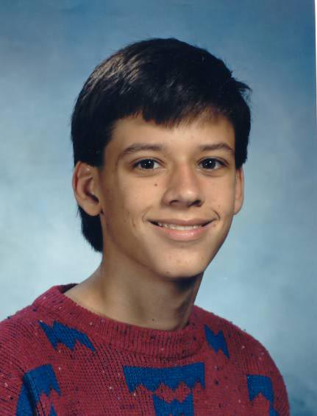
Tony

Slide 47
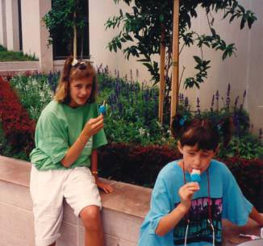
No more museums, OK, Dad?

Slide 48
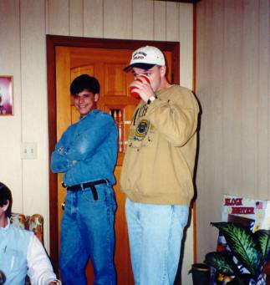
Tony at Christmas

Slide 49
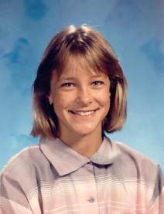
Suzy at 12

Slide 50
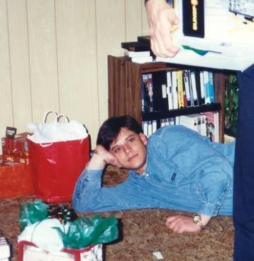
Tony

Slide 51
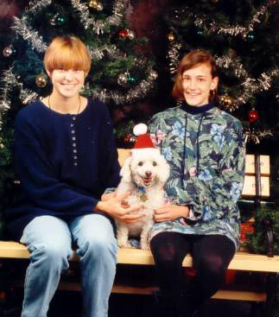
Suzy and Julie with Sugar-Elf

Slide 52

Tony

Slide 53

Suzy backpacking with Dad in Europe

Slide 54

Tony and Jennifer

Slide 55

Suzy at 18

